Slide 1

ANNAMACHARYA INSTITUTE OF TECHNOLOGY AND SCIENCES, RAJAMPET
(AN AUTONOMOUS INSTITUTION)
DEPARTMENT OF COMPUTER SCIENCE AND ENGINEERING(ARTIFICIAL INTELLIGENCE)
A Project Review on
“Enhancing Emergency Care Through Machine Learning Based Admission Prioritization ”
Under the Esteemed Guidance of
Dr.C.V.Lakshmi Narayana MTech, Ph.D.,
Assistant Professor
Department of AIML,
Annamacharya University, Rajampet,516126.
Submitted by
K.REVATHY (Roll No:22701A3135)
D.KARTHIK (Roll No:22701A3122)
P.USHA SREE (Roll No:22701A3144)
M.SUNIL (Roll No:22701A3142)
S.MANOJ KUMAR (Roll No:23705A3103)

Slide 2
contents
Abstract
Introduction
Problem statement
Literature survey
Hardware and Software requirements
Existing System
Proposed System
System Architecture
Modules/Algorithm
System Design
Testing and Results
Conclusion and Future Enhancements
References

Slide 3
ABSTRACT
Emergency departments often face overcrowding, delayed treatment, and difficulty in identifying high-risk patients who need immediate care. This project presents a machine learning-based admission prioritization system to improve emergency care efficiency and patient safety. By analyzing patient data such as age, medical history, vital signs, symptoms, and severity of condition, the system predicts patient risk levels and prioritizes admissions accordingly. Supervised machine learning algorithms are trained on historical emergency department data to identify patterns associated with critical outcomes like hospitalization, ICU admission, or mortality. The proposed approach supports real-time, data-driven triage decisions, resource utilization, and minimizes staff workload. By incorporating explainable AI principles, the system ensures transparency, fairness and trust in medical decision-making. Overall, this solution enhances emergency care delivery by combining clinical expertise with intelligent, predictive technologies for faster and more accurate admission prioritization.

Slide 4
INTRODUCTION
Emergency departments play a vital role in providing immediate medical care to patients with critical and life-threatening conditions.
Due to increasing patient inflow, emergency departments often face overcrowding and limited medical resources.
Traditional triage and admission prioritization are mostly manual and depend on human judgment, which may lead to delays in critical care.
Large volumes of patient data such as vital signs, medical history, symptoms, and electronic health records are available but not effectively utilized.
Machine learning techniques can analyze large datasets, identify hidden patterns, and predict patient risk levels accurately.
By learning from historical emergency department data, ML models help prioritize patients who require urgent medical attention.
This project proposes a machine learning-based admission prioritization system to support faster decision-making, improve patient safety, and enhance emergency care efficiency.

Slide 5
PROBLEM STATEMENT
Emergency Departments (EDs) often experience severe overcrowding due to high patient inflow and limited medical resources.
Manual triage and admission prioritization processes may cause delays in identifying patients who require immediate and critical care.
Delay in treatment of high-risk patients can lead to serious complications, increased mortality, and reduced quality of care.
Large amounts of patient data such as electronic health records, vital signs, and medical history remain underutilized in decision-making.
Existing systems lack accurate and reliable machine learning-based models for real-time emergency admission prioritization.
Healthcare staff face high workload and exhaustion due to inefficient patient flow management in emergency settings.

Slide 6
LITERATURE SURVEY
Researchers have explored the use of machine learning techniques to predict hospital admissions from emergency department data with good accuracy.
Supervised learning models such as Logistic Regression, Decision Trees, Random Forests, and Neural Networks have been widely used for emergency triage and risk prediction.
Studies show that machine learning models can effectively differentiate between critical patients (ICU admission, mortality) and non-critical patients (discharge or general admission).
Electronic Health Records (EHRs), vital signs, laboratory results, and patient medical history are commonly used as input features for prediction models.
Real-time prediction models have demonstrated improved decision-making efficiency compared to traditional manual triage methods.
Some researcher highlights challenges such as data imbalance, missing values, and limited generalization across different hospitals.
Existing studies emphasize the need for explainable and reliable ML models that can be integrated into real-world emergency department workflows.

Slide 7
Publication | Journal Name | Title | Author | Year | Method Used | Application
Supervised Machine Learning for Emergency Room Triage | Journal of Emergency Medicine | Supervised Machine Learning Techniques for Forecasting Patient Triage Outcomes | Hamza Elhaj et al. | 2025 | Supervised ML Models | Effectively distinguished critical cases (ICU, mortality) from non-critical cases, reducing waiting time and overcrowding.
Predictive Modeling for Emergency Hospital Admissions | Health Care Management Science | Predictive Models for Emergency Hospital Admissions | Neophytos Stylianou et al. | 2024 | Statistical Models, Machine Learning | Identified high-risk patients using routine healthcare data, enabling early intervention and preventive care.

Slide 8
Publication | Journal Name | Title | Author | Year | Method Used | Application
Real-Time Inpatient Length of Stay Prediction | IEEE Journal of Biomedical and Health Informatics | Real-Time Prediction of Inpatient Length of Stay | Sean Barnes et al. | 2023 | Machine Learning Models | Achieved clinician-level performance and improved discharge prioritization and hospital resource utilization.
Deep Learning-Based Emergency Admission Prioritization | IEEE / Healthcare AI Conferences | Deep Learning for Emergency Admission Prioritization | Multiple Researchers | 2021 | MLP, LSTM | LSTM captured temporal patterns in HER and vital signs, providing higher accuracy than traditional ML models

Slide 9
HARDWARE AND SOFTWARE REQUIREMENTS
HARDWARE REQUIREMENTS:
Processor: Intel i3/i5 or higher
RAM: 8 GB
Hard Disk: 160 GB or above
System Type: Standard desktop or laptop suitable for ML model training
SOFTWARE REQUIREMENTS:
Operating System: Windows 10 or later
Programming Language: Python 3.6 or above
Libraries: NumPy, Pandas, Scikit-learn
Database: MySQL
Development Tools: PyCharm, VS Code, Jupyter Notebook
Framework/Tools: Django
Technology: Machine Learning

Slide 10
EXISITING SYSTEM
Emergency admission decisions are mostly manual and depend on doctors’ experience and traditional triage methods.
Uses classical statistical and basic machine learning models such as:
Logistic Regression
Naïve Bayes
Random Forest
Support Vector Classifier (SVC)
Models work on static patient data and do not capture time-based changes.
Limited use of Electronic Health Records (EHRs) and real-time patient monitoring data.
Single-model approach without integrating multiple data sources.
Disadvantages:
Sudden patient inflow
Critical and complex emergency cases
Leads to delays in critical care and emergency department overcrowding.

Slide 11
PROPOSED SYSTEM
Introduces an AI and Machine Learning-based emergency admission prioritization system.
Uses multimodal patient data, including:
Electronic Health Records (EHRs), Vital signs, Laboratory results, Medical history, Emergency department workload data
Implements advanced machine learning and deep learning models:
Logistic Regression, Naïve Bayes, Random Forest, SVC, Multilayer Perceptron (MLP), Long Short-Term Memory (LSTM)
LSTM model effectively captures:
Sequential and time-dependent patient data
Rapid changes in patient condition
Supports faster, accurate, and data-driven clinical decisions.
Provides real-time risk scoring and admission priority.
Advantages:
Improved prediction accuracy
Reduced patient waiting time
Better handling of critical emergencies
Optimized hospital resource utilization and reduced emergency department overcrowding

Slide 12
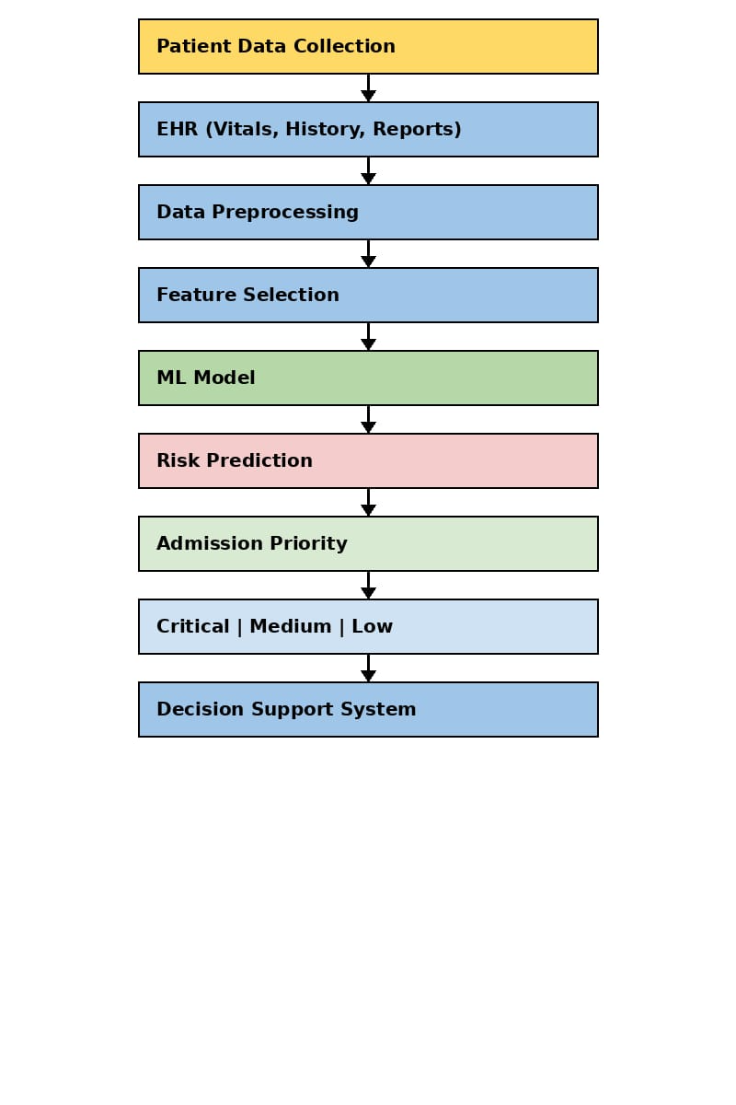
SYSTEM ARCHITECTURE

Slide 13
MODULES
Data Collection Module
This module collects patient data from Electronic Health Records (EHR) and hospital databases. The data includes patient age, symptoms, medical history, laboratory reports and vital signs such as blood pressure, heart rate, and oxygen level.
Data Preprocessing Module
The collected data may contain missing values and noise .This module performs data cleaning, normalization, and transformation to prepare dataset for machine learning model training.
3. Feature Selection Module
In this module, important medical features related to patient health are selected. These features help the
System analyze patient conditions and improve prediction accuracy.

Slide 14
MODULES
Machine Learning Model Module
This module trains machine learning algorithms such as Logistic Regression, Naïve Bayes, Random Forest, Support Vector Classifier (SVC), Multilayer Perceptron (MLP), and LSTM to learn patterns from historical patient data.
Risk Prediction and Prioritization Module
The trained module predicts the risk level of each patient based on input data. Patients are classified
into High Risk, Medium Risk, and Low Risk categories to help doctors prioritize emergency
admissions.

Slide 15
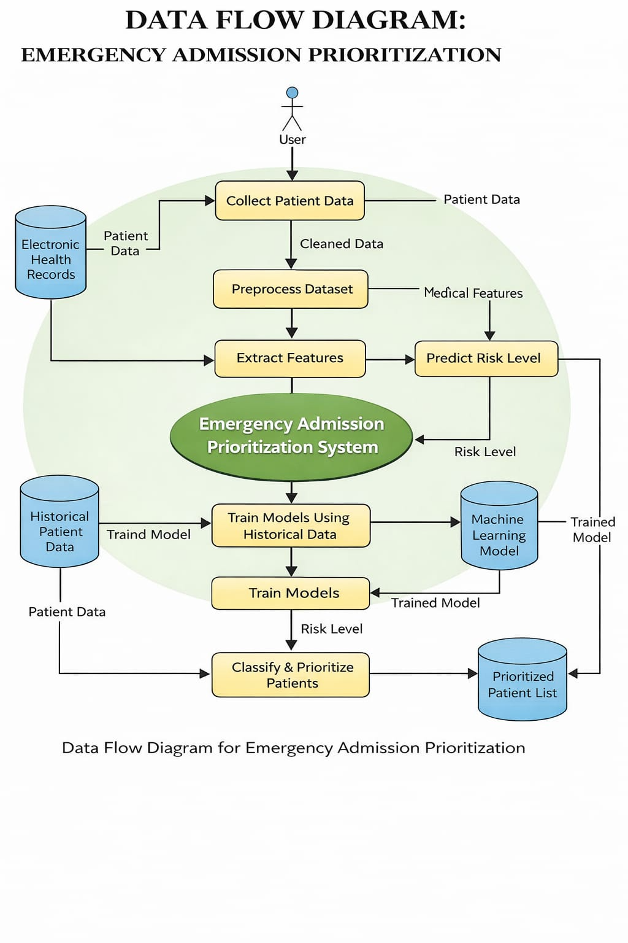
ALGORITHM
Algorithm: Emergency Admission Prioritization
Start
Collect patient data from Electronic Health Records
Preprocess the dataset (cleaning and normalization)
Extract important medical features
Train machine learning models using historical data
Input new patient data into the trained model
Predict patient risk level
Classify patients into High, Medium, or Low priority
Display prioritized patient list to emergency staff
End

Slide 16
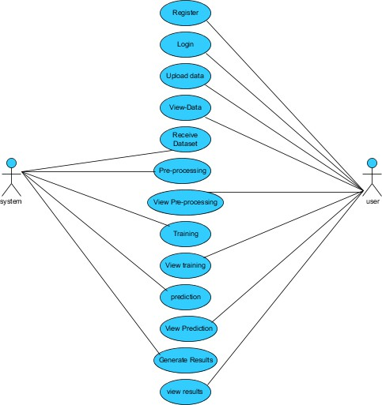
SYSTEM DESIGN
Use case Daigram:
A use case diagram in UML visually represents a system’s functionality.
It shows actors, their goals (use cases), and relationships between them.
Its main purpose is to depict which system functions are performed for each actor.

Slide 17
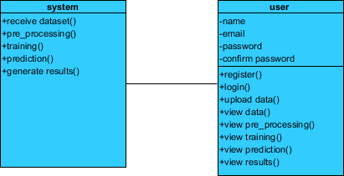
SYSTEM DESIGN
Class Daigram:
A class diagram in UML is a static structure diagram that shows the system’s structure.
It represents classes, their attributes, methods, and relationships.
It helps explain how information is organized within different classes.

Slide 18
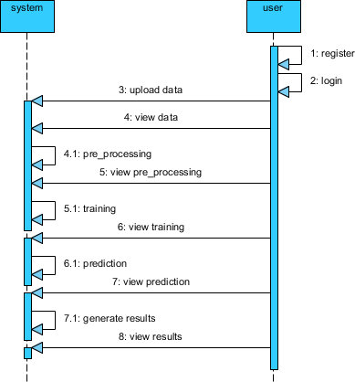
SYSTEM DESIGN
Sequence Daigram:
A sequence diagram in UML is an interaction diagram that shows how processes communicate and in what order.

Slide 19
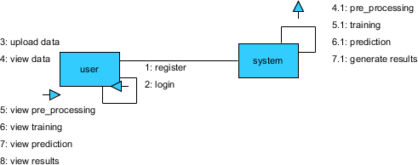
SYSTEM DESIGN
Collaboration Diagram:
A collaboration diagram shows method call sequences using numbering, indicating the order of interactions between objects.
Unlike sequence diagrams, it focuses on object organization while still representing similar method calls.

Slide 20

SYSTEM DESIGN
Deployment Diagram:
A deployment diagram represents the deployment view of a system and shows how components are deployed.
It consists of nodes, which are physical hardware used to run the application.

Slide 21
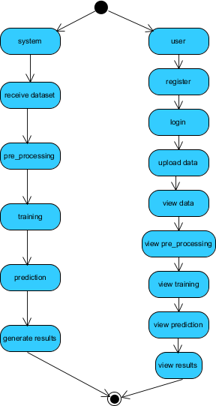
SYSTEM DESIGN
Activity Diagiiram:
An activity diagram represents workflows of step-by-step activities and actions.
It supports decision making, iteration, and parallel processes.
It shows the overall flow of control in a system or business process.

Slide 22
SYSTEM DESIGN
Activity Diagiiram:
A component diagram shows the organization and connections of physical components in a system.
It helps model implementation details of the system.
It ensures all required functionalities are covered in development..

Slide 23
TESTING
Unit Testing
Unit testing verifies individual components of a program after development to ensure that internal logic works correctly. It checks whether given inputs produce the expected outputs and validates all code paths and decision branches within a unit.
Integration Testing
Integration testing focuses on combining different modules and testing them as a complete system. It ensures that the interaction between components works correctly and helps identify issues that arise when separate units are integrated.
Functional Testing
Functional testing validates that the system’s features operate according to the specified requirements. It checks the handling of valid and invalid inputs, verifies outputs, and ensures that all functions behave as expected.
System Testing
System testing evaluates the fully integrated application as a whole to ensure it meets all specified requirements. It focuses on overall system performance, workflows, and reliability in a complete operating environment.

Slide 24
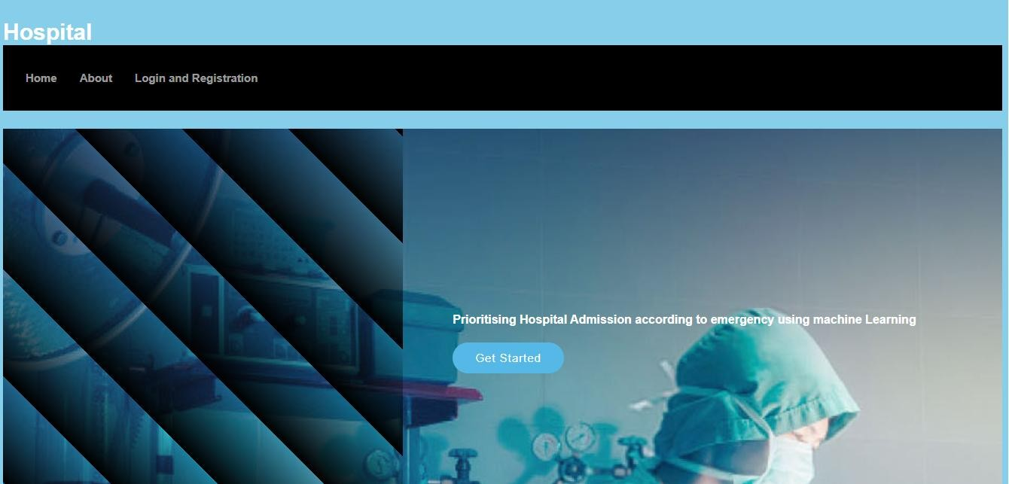
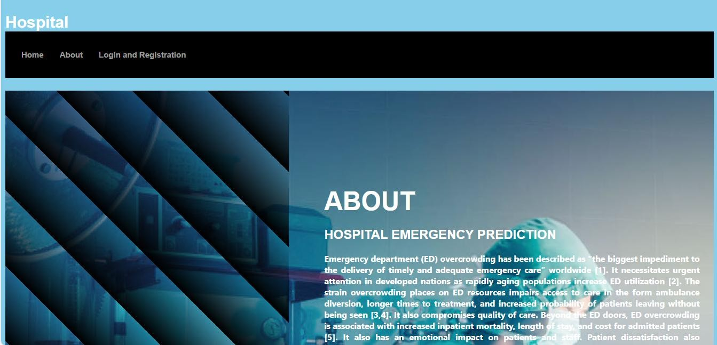
RESULTS
Home Page
About Page

Slide 25
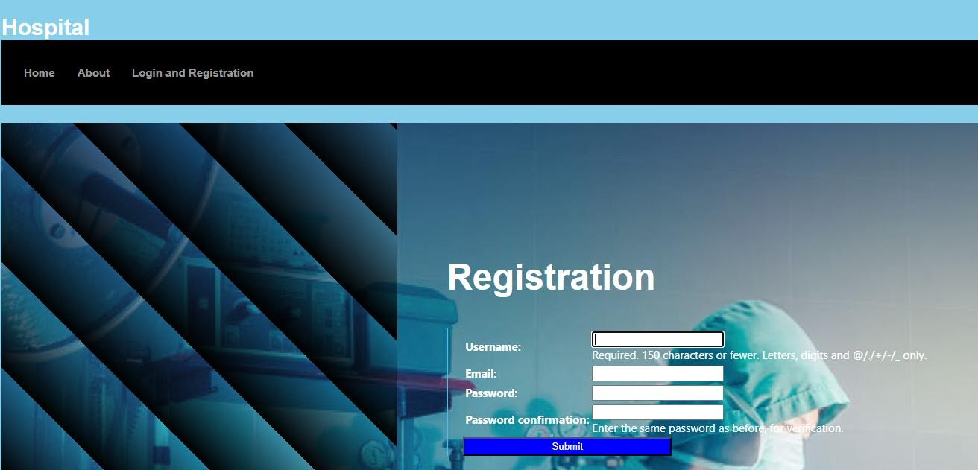
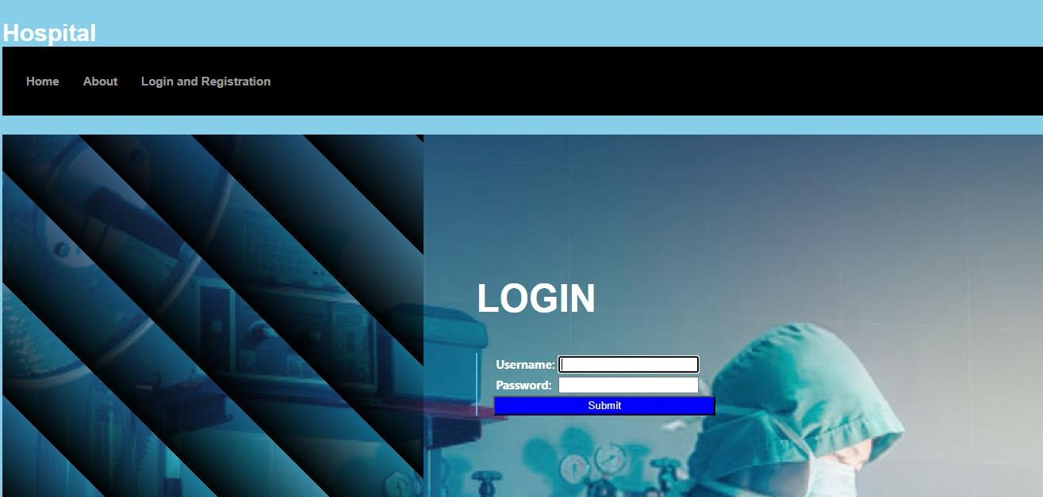
RESULTS
User Registration.
User Login.

Slide 26
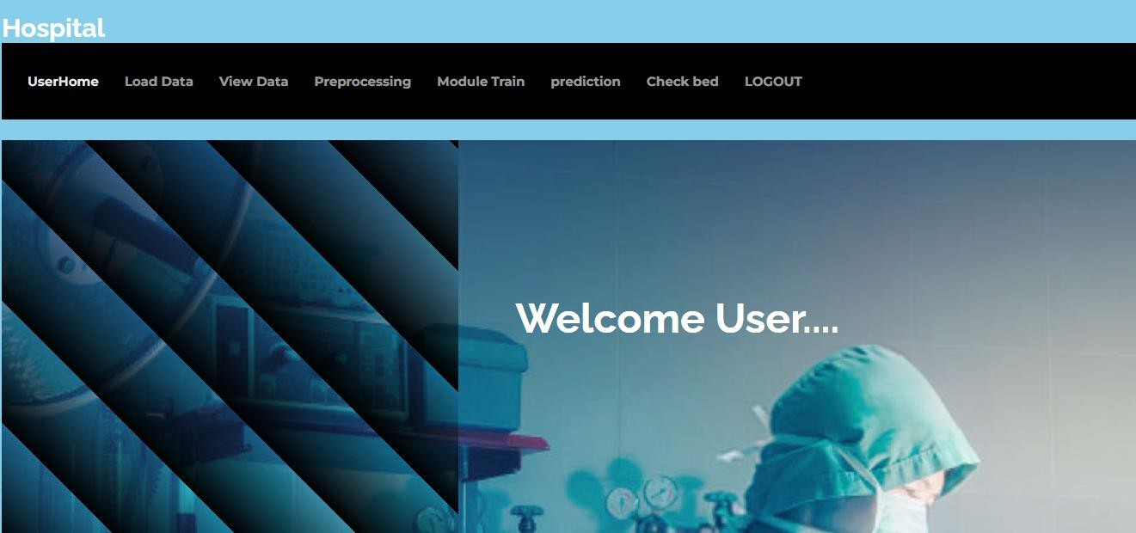
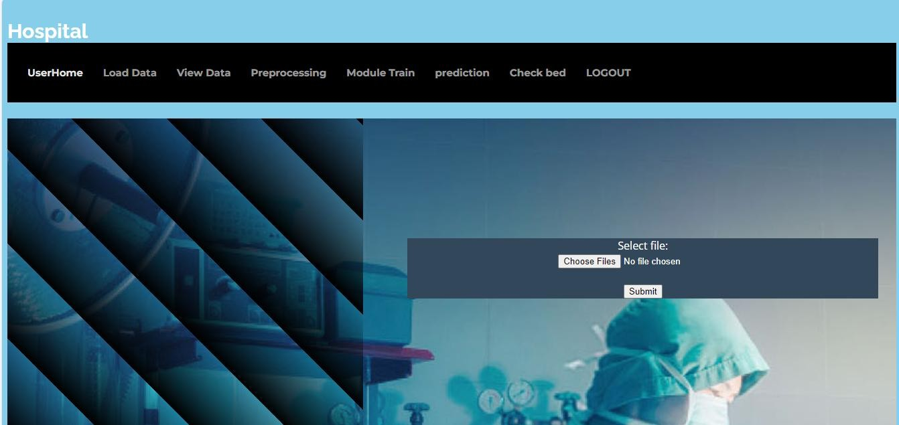
RESULTS
User Home Page.
Upload Data.

Slide 27
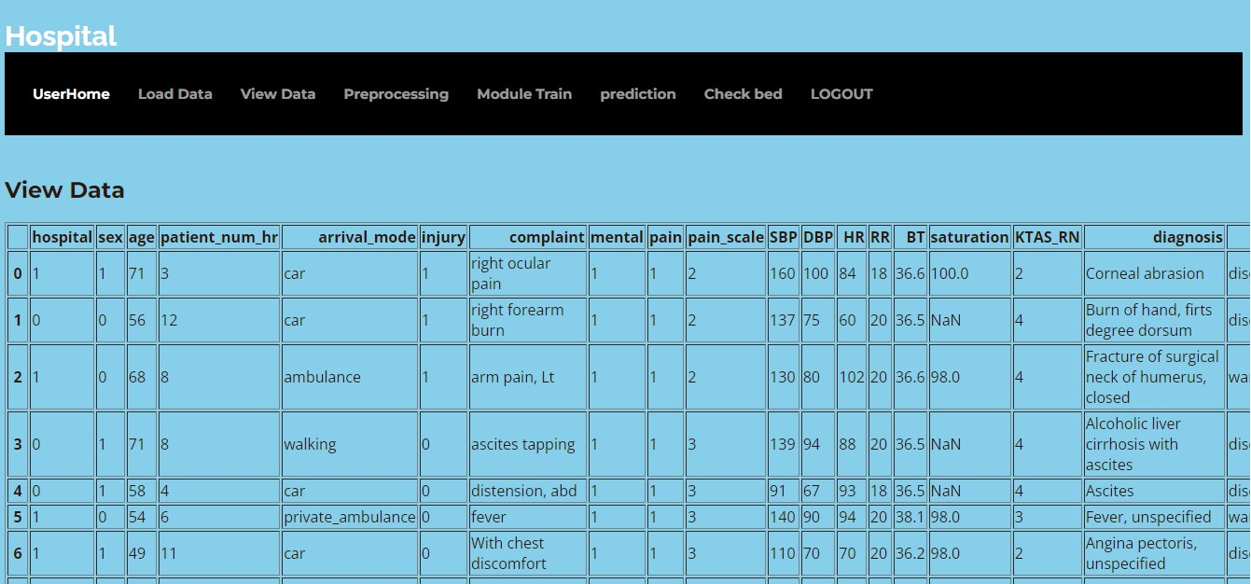
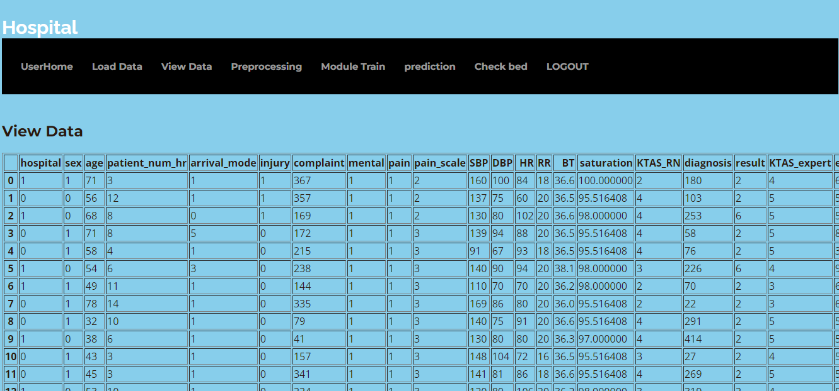
RESULTS
View Data.
Preprocessing

Slide 28
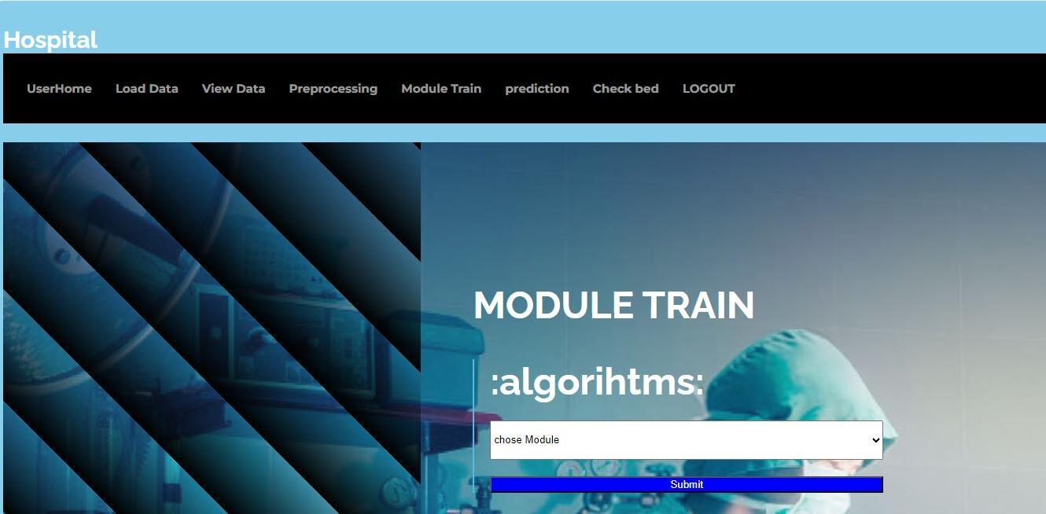
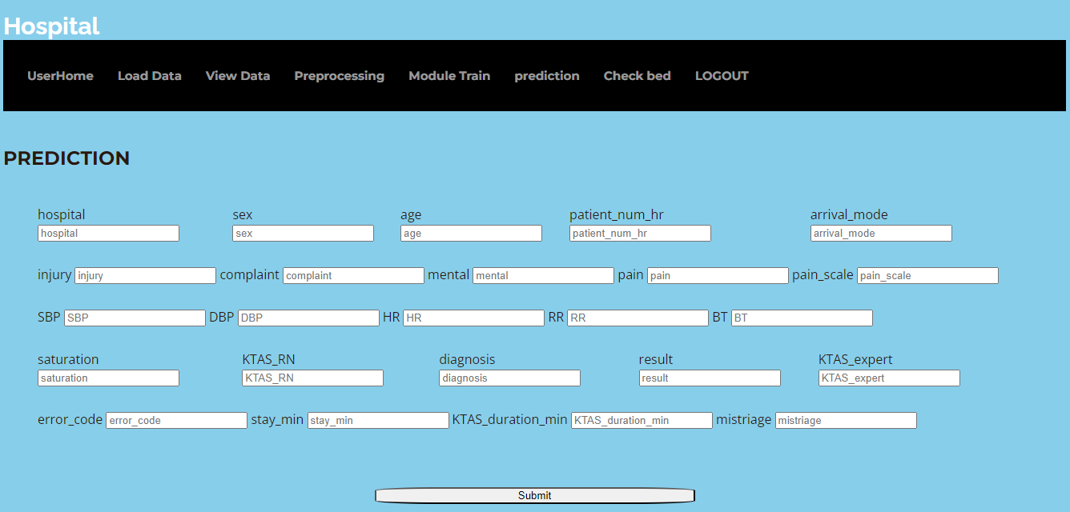
RESULTS
Model Page.
Prediction

Slide 29
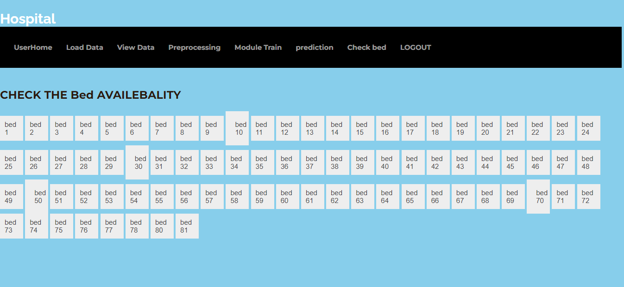
RESULTS
Check bed Availability.

Slide 30
CONCLUSION AND FUTURE ENHANCEMENT
CONCLUSION
This project shows how machine learning can prioritize hospital admissions based on emergency severity.
The model improved patient outcomes and reduced hospital overcrowding.
It highlights the importance of machine learning in optimizing healthcare resources.
FUTURE ENHANCEMENT
Further research is needed to validate and expand the results.
More studies will improve reliability and wider applicability in emergency care.

Slide 31
REFERENCES
N. Larburu, L. Azkue & J. Kerexeta, “Predicting Hospital Ward Admission from the Emergency Department: A Systematic Review,” J. Personalised Medicine, 2023.
S. Sezik, M. Ö. Cingiz & E. İbiş, “Machine Learning-Based Model for Emergency Department Disposition,” Applied Sciences, 2025 (data from 2022–23).
A. J. Zeleke et al., “Machine Learning-Based Prediction of Hospital Prolonged Length of Stay at the ED,” Frontiers in Artificial Intelligence, 2023
G. Feretzakis, G. Karlis et al., “Using Machine Learning Techniques to Predict Hospital Admission at the Emergency Department,” Int. J. Med. Informatics, 2022.
R. A. de Hond et al., “Machine Learning for Developing a Prediction Model of Hospital Admission of ED Patients,” Int. J. Med. Informatics, 2021–22.

Slide 32
THANK YOU!

